Slide 1
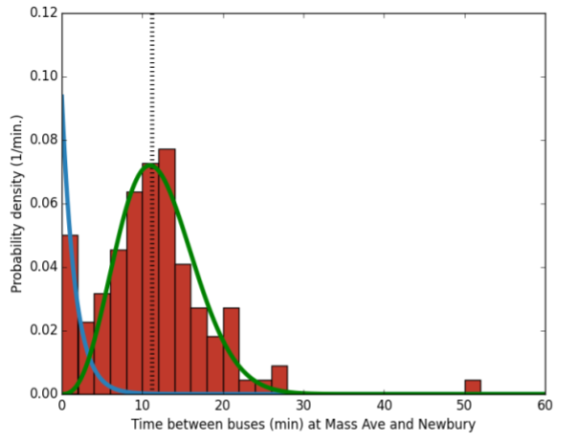
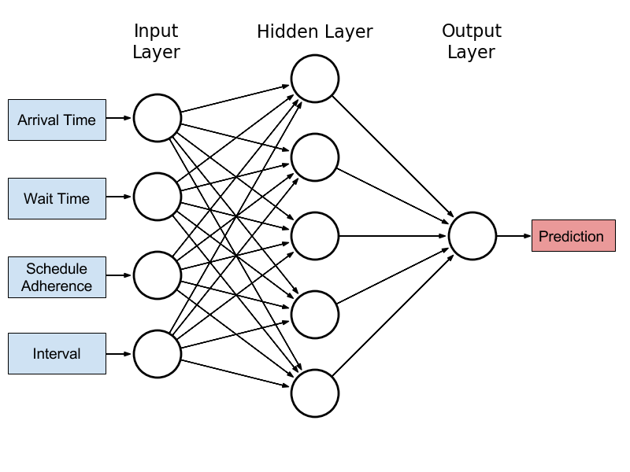
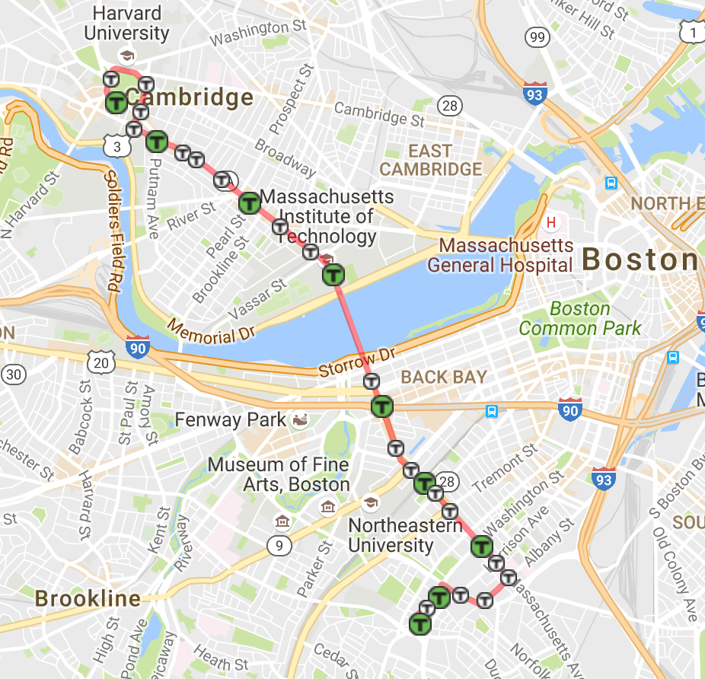
EECS
MIT EECS Undergraduate Research
and Innovation Scholar
Neural Nets for Bus Arrival Time Prediction
Cooper Sloan, Alan Edelman, Jiahao Chen
PROBLEM
ARCHITECTURE
Being able to accurately predict arrival times and delays is a key to optimizing network traffic
In the context of public transit systems accurate prediction of bus arrival times reduces passenger wait times and improves efficiency
Current models do not incorporate both machine learning and statistical models and are limited in their accuracy
This project uses the Massachusetts Bay Transportation Authority dataset which spans several years with the goal of accurately predicting bus arrival times
Statistical Models: Poisson Distribution and Gaussian Unitary Ensemble¹
Machine learning methods such as neural nets have some success²
Proposed solution: Mixed model including deep neural net combined with statistical model
Model trained across several years of data
Root Mean Square Error used to measure model utility
APPROACH
1 bus: travels between Boston and Cambridge
GPS data from the MBTA -> Arrival time for each stop
Data partitioned by:
Time of day (rush hour, midday…)
Day of the week
Season
Other Relevant Features:
schedule adherence: difference between scheduled arrival time and actual arrival time
dwell time: the amount of time the bus stays at each stop
Features serve as inputs to the data model
Model outputs predicted arrival time
Figure 2: Histogram of bus arrival time intervals
Figure 3: Sample neural net architecture⁴
NEXT STEPS
Refine models and determine best predictors for bus arrival time
Compare accuracy of models across routes
Determine online method to generate real time predictions
Works Cited
Krbálek, Milan, and Petr Seba. "The statistical properties of the city transport in Cuernavaca (Mexico) and random matrix ensembles." Journal of Physics A: Mathematical and General 33.26 (2000): L229.
Jeong, Ranhee, and Laurence R. Rilett. "Bus arrival time prediction using artificial neural network model." Intelligent Transportation Systems, 2004. Proceedings. The 7th International IEEE Conference on. IEEE, 2004.
Figure 1: 1 Bus route through Boston and Cambridge

